Slide 1
Veteran Demographic Data
Jacob mcmillan

Slide 2
Topics to Discuss and Highlights
This presentation will look at military veteran population demographics broken down in various categories, such as: ethnicity, sex, age group, rank, state and county locations, branch of service, rank, era of armed conflict served
The dataset was published by the Department of Veterans Affairs on Data.gov with 2018 data and data projections of living Veterans
Will be focusing on 2021 data along with projections to show trends

Slide 3
There are about 18 million veterans in the United States

Slide 5
Ethnicity Demographics for Veterans

Slide 7
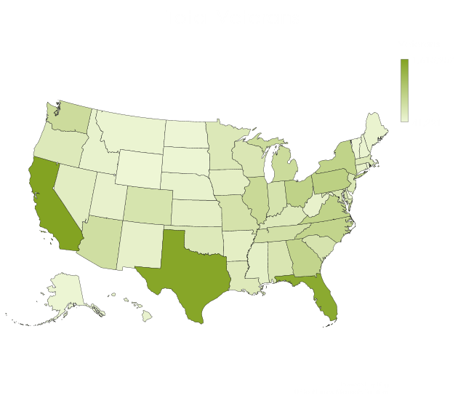
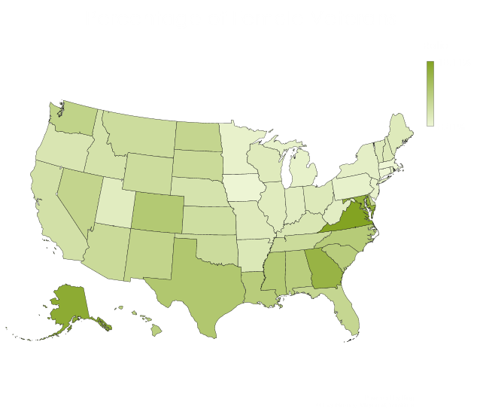
Gender Demographics by State

Slide 8
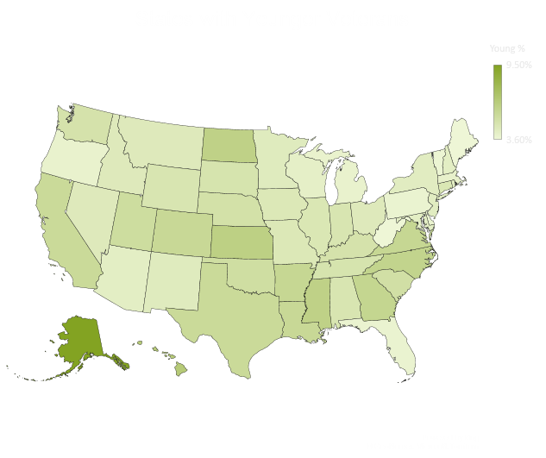
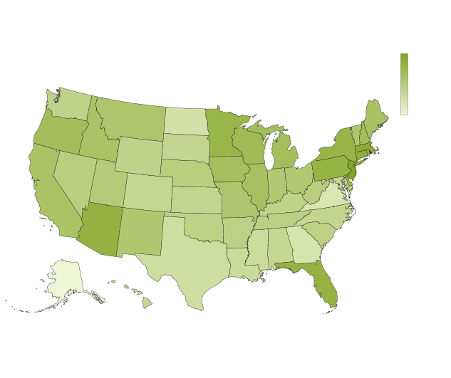
Age Groups of Veterans by State

Slide 9
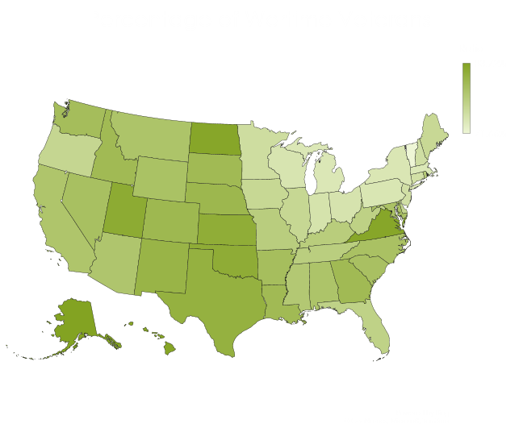
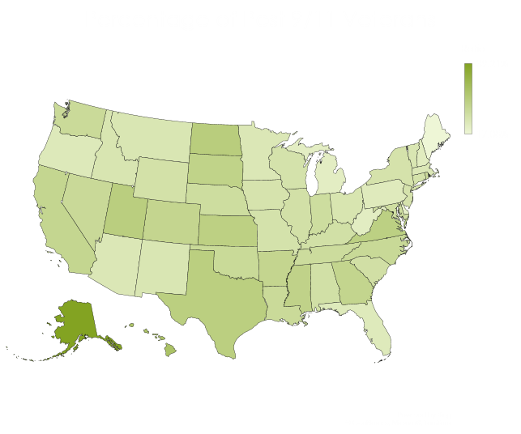
Eras of Armed Conflict by State

Slide 10
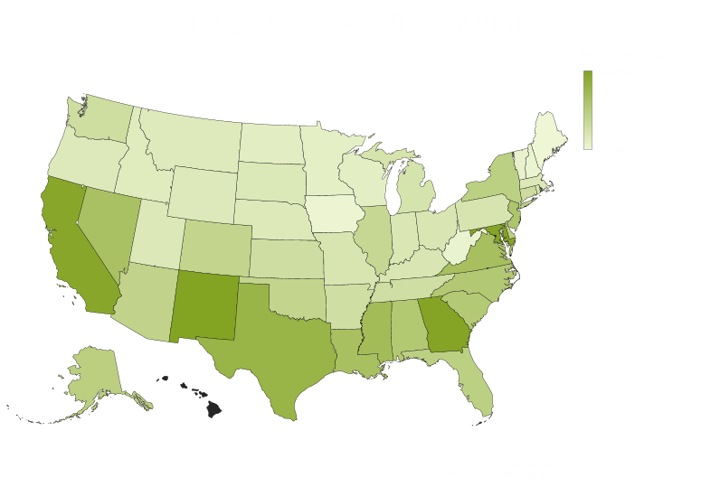
Ethnicity Demographics by State
86% of veterans in Hawaii are American minorities

Slide 11
Projected Veteran Population by Era of Conflict

Slide 12
Comments or Questions?

